Slide 1

A Christlike Descent Into Greatness
2:1 – 11
Week 34
2 November 2022

Slide 2

Philippians overview chapter two
In the first chapter, Paul included an exhortation to stand fast in one spirit, with one mind striving together for the faith of the gospel (1:27). Here in the second chapter, Paul continues with the call for unity, provides reasons why we should desire unity, talks about the nature of our unity, and the attitudes necessary to maintain unity (1-4).
Stressing the need for humility and sacrificial service towards others, Paul appeals to the example of Christ and expounds upon how far Christ was willing to go to save us (5-11).

Slide 3
Philippians Overview chapter two
Paul continues his exhortation to the Philippians to “shine as lights in the world” as they work out their own salvation with fear and trembling. Doing all things without complaining and arguing, while holding fast the word of life, they will prove themselves to be children of God in the midst of a crooked and perverse generation (12-16).
Which will prove to Paul that his labors has not been in vain, and shows that any persecution he endured was viewed as a sacrifice in the service of their faith and a cause for mutual rejoicing (17-18).

Slide 4
Philippians overview chapter two
Paul then writes of his plans pertaining to Timothy and Epaphroditus. He will send Timothy shortly, that he might learn of their condition (19-24).
But Epaphroditus is coming at once in order to set their hearts at ease about Epaphroditus’ brush with death due to his recent illness (25-30).

Slide 5


Slide 6

“A Christlike Descent Into Greatness”

Slide 7
Philippians 2:1 – 11
The key verse in this epistle is Philippians 1:21 > “For to me, to live is Christ and to die is gain.” Paul knew that to experience martyrdom and to be ushered into the presence of Christ would be a great gain. But he also knew that God had much more work for him to do in the here and now and that he was called to encourage others to live like Christ.
But how do we truly live like Christ? How do we possibly begin to take even one small step closer toward the greatness Christ exhibited as the God-man? Is there a certain series of deeds we need to do? Fruitless! Do we attempt to mimic His miracles? Impossible! Do we become little gods or little messiahs to conform to His divine nature? Blasphemy!

Slide 8
Philippians 2:1 – 11
No. We’re told in the first part of this chapter what it will take. It’s actually quite simple, really. In fact, we can reduce it to just two words: selfless humility.
But just because it’s simple doesn’t mean it’s easy. Genuine Christ-likeness means embodying and expressing a virtue that’s rarely seen on earth. But when it is, we can begin to experience what it is to live as He lived.

Slide 9
Philippians 2:1 – 4
¹Therefore if there is any consolation in Christ, if any comfort of love, if any fellowship of the Spirit, if any affection and mercy, ²fulfill my joy by being like-minded, having the same love, being of one accord, of one mind. ³Let nothing be done through selfish ambition or conceit, but in lowliness of mind let each esteem others better than himself. ⁴Let each of you look out not only for his own interests, but also for the interests of others.

Slide 10
Philippians 2:1 – 4
“What’s the secret to a great life?” People have pondered this question for millennia—since long before there was a self-help section at a bookstore . . . or twinkle-eyed preachers trading in shallow “believe in yourself” platitudes . . . or cabinets full of supplements and drugs to increase our energy or enhance our effectiveness.
The Bible’s answer to that question isn’t long, convoluted, or complex. As already indicated, we can sum it up in two words: selfless humility. Not the kind we conjure through mantras or summon through meditation or instill through methods of behavior modification. This is a super-natural kind of selfless humility that has its source in our identification with and imitation of Christ. It results in love, fellowship; affection, compassion, unity, service, and joy.

Slide 11
Philippians 2:1 – 4
Of all the virtues Christ embodied, selfless humility seems to sum up well His overall character. Jesus Himself said as much to His disciples: “Whoever wishes to become great among you shall be your servant, and whoever wishes to be first among you shall be your slave; just as the Son of Man did not come to be served, but to serve, and to give His life a ransom for many” (Matt. 20:26-28).
Christ taught—through words and actions—a descent into greatness. Paul unpacks this principle of “selfless humility” in Philippians 2:1-11, but begins in 2:1-4 with tangible results of Christlike selfless humility before focusing on an example of it in 2:5-11.

Slide 12
Philippians 2:1 – 4
In 2:1 a logical (and theological) basis or motivation for the command “make my joy complete,” is given. Paul’s use of the four “ifs” in 2:1 aren’t meant to communicate uncertainty, as if Paul wasn’t sure whether there was encouragement in Christ, consolation of love, fellowship of the Spirit, or affection and compassion in the Christian life.
Rather, these things are assumed to be true. The “if” clauses imply a logical or reasonable relationship: Because these things are true, then there should be an associated effect. It’s like a dad saying to his son, “If you’re my son, and if I’m your father, and if you’re only seven, and if I’m the head of this home, then clean your room.”

Slide 13


Slide 14
Philippians 2:1 – 4
On the other side of the pivotal command (“make my joy complete”) stand four means by which Paul’s joy may be filled through the Philippians’ response. In fact, the requests in 2:2 mirror the positive assertion in 2:1.
“Being of the same mind” (2:2) doesn’t mean that all believers are expected to agree on every minor issue of doctrine, or suppress individuality. It means they’re to get along, agreeing on the supremacy of Christ and the centrality of the fundamentals of the faith. Paul encourages them, in light of their spiritual oneness in Christ, to be in harmony and in unity. In this Christlike unity, believers can maintain selfless love toward each other and direct their purposes toward the same goal—pro claiming Christ and helping others grow in their relationship with Him.

Slide 15


Slide 16
Philippians 2:1 – 4
While the “one mind” Paul urges for the Philippians—and for us—to have is one of selfless humility. But how is such a feat accomplished? Paul provides some snapshots of selfless humility in 2:3-4. Those who embody this Christlike virtue will not let selfishness or conceit motivate their attitudes, words, or actions.
They will regard others as more important than themselves. They won’t limit their focus to just their own interests. They’ll give attention to the needs of others. But saying you’ll behave this way and actually doing it are two different things. This is why Paul turns next to the crux of selfless humility: the person and work of Christ.

Slide 17


Slide 18


Slide 19
Philippians 2:5 – 11
⁵Let this mind be in you which was also in Christ Jesus, ⁶who, being in the form of God, did not consider it robbery to be equal with God, ⁷but made Himself of no reputation, taking the form of a bondservant, and coming in the likeness of men. ⁸And being found in appearance as a man, He humbled Himself and became obedient to the point of death, even the death of the cross. ⁹Therefore God also has highly exalted Him and given Him the name which is above every name, ¹⁰that at the name of Jesus every knee should bow, of those in heaven, and of those on earth, and of those under the earth, ¹¹and that every tongue should confess that Jesus Christ is Lord, to the glory of God the Father.

Slide 20
Philippians 2:5 – 11
Presenting Jesus Christ as the supreme example and source of true selfless humility; Paul, in one of the most eloquent passages of Scripture regarded as a hymn sung in celebration of Christ’s person and work, he describes Jesus’s glorious life both before and after His selfless humility expressing His incarnation and death on the cross.
In 2:5 Paul sets up the hymn, which is then relayed in 2:6-11. he says, “Have this attitude in yourselves which was also in Christ Jesus” (2:5). To understand the extent of selfless humility expected of followers of Christ, we look to the One who is humility incarnate. When we reflect on His person and work, letting this reflection inform our minds and invade our hearts, it will transform our lives by the power of the Holy Spirit.

Slide 21
Philippians 2:5 – 11
This Christ hymn can be outlined in three basic movements:
the Son of God in glory before coming to earth (2:6)
the Son of God in selfless humility on earth (2:7-8)
the Son of God in glory after leaving earth (2:9-11)
The Son of God in glory before coming to earth (2:6). Prior to the incarnation, before the fully divine Son of God—the second person of the eternal Trinity—took on a fully human nature. He existed in eternity in equality with God the Father and God the Holy Spirit. Jesus existed in the form of God means He had an outward appearance consistent with what is true of God. A form perfectly expresses the inner reality of the deity of God.

Slide 22
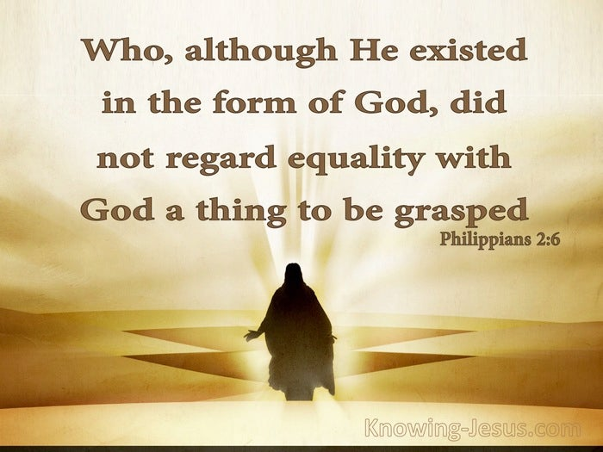

Slide 23
Philippians 2:5 – 11
This preincarnate existence is further described by the next phrase: “equality with God.” Before coming to earth, the Son was fully divine in nature and attributes.
This idea of the full deity of the Son of God is taught elsewhere in the New Testament. Jesus prayed, “Father, glorify Me together with Yourself, with the glory which I had with You before the world was” (John 17:5).
In describing Jesus, the apostle John wrote, “In the beginning was the Word, and the Word was with God, and the Word was God” (John 1:1).
The author of Hebrews affirms that God the Son is “the radiance of [God’s] glory and the exact representation of His nature” (Heb. 1:3).

Slide 24
Philippians 2:5 – 11
But what does it mean that Christ “did not regard equality with God a thing to be grasped” (2:6)? In the “negative” context, the “thing to be grasped” refers to the act of robbery or the loot gained by plundering. Clearly this isn’t the meaning in 2:6. Christ couldn’t have tried to rob God of His divine power; divine power was something the Son possessed by being the eternal Son of the eternal Father.
In the “positive” context, the “thing to be grasped” could mean something like “a great benefit” or “a favorable lot,” like the glory, honor, power, and title that a prince might have by being the son of a king. In this case, the statement that Christ did not regard “equality with God” to be a “thing to be grasped” would mean that . . .

Slide 25
Philippians 2:5 – 11
. . . that even though as the eternal Son, the glory, honor, power, and title of deity are His. Jesus did not take the attitude of a spoiled brat who basked in His own glory. The one existing in the form of God did not consider it an advantage to exploit the idea of being equal to God.
Though he could have clutched the heavenly glory He had with the Father before time and space came into being—and he had every right to do so—He didn’t. Christ voluntarily acted with an attitude of selfless humility, not with an air of self-focused superiority.
Along these lines, Clement of Rome, in his own letter urging Christians to humility, seems to be reflecting on Paul’s Christ hymn of Philippians 2 when he writes:

Slide 26
Philippians 2:5 – 11
“For Christ is of those who are humble-minded, not of those who exalt themselves over his flock. The scepter of the majesty of God, the Lord Jesus Christ, did not come with the pomp of arrogance or pride (although he could have) but with humble-mindedness.”
Think about this. God the Son—eternal, all-powerful—didn’t regard His exalted position as something to be grasped. Nothing within Him tempted Him to exploit His preeminent position as absolute Sovereign over all. Why not? Because of His perfect love for humanity manifested in selfless humility.
In a state of absolute perfection and full control, Jesus willingly stepped out of His rightful realm of glory for the sake of humanity.

Slide 27
Philippians 2:5 – 11
Though encompassed by an angelic chorus of perpetual praise, the Son unselfishly came to dwell among those who would curse and abuse Him. Though enwrapped in the radiant light of His own divine glory, God the Son put a veil of flesh over His glory—not diminishing it or extinguishing it, but concealing it—all on behalf of a cold, dark world that sought to plunge Him into the shadow of death.
What an incomprehensible, unfathomable example of selfless humility!
The Son of God in selfless humility on earth (2:7-8). The second movement of Paul’s Christ hymn portrays the heavenly Sovereign as becoming the earthly Sufferer. In His voluntary descent from heavenly glory to earthly agony, Christ’s humility doesn’t even stop in the face . . .

Slide 28
Philippians 2:5 – 11
. . . in the face of the most excruciating form of torture and execution in the ancient world. Consider the steps that Jesus took to share our humanity and die for our sins according to the Father’s plan and His own voluntary selfless humility:
He emptied Himself (veiling His glorious divine power).
He took the form of a bond-servant (becoming fully human).
He humbled Himself in obedience unto death (submitting to God’s plan).
He accepted a most humiliating death: crucifixion (making atonement for sinners).

Slide 29
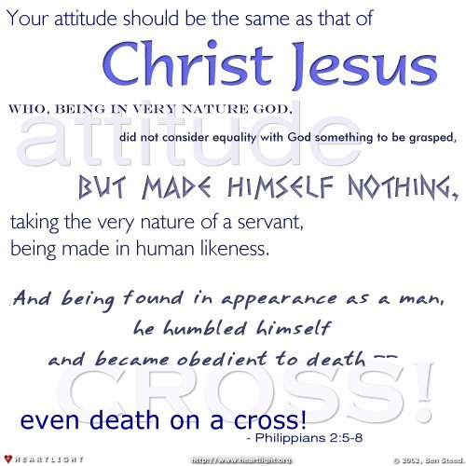

Slide 30
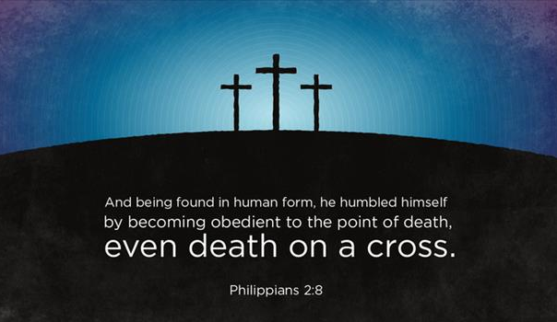

Slide 31
Philippians 2:5 – 11
Many scholars refer to this poetic section of Philippians as the “kenosis hymn” because of the vivid use of the verb “kenoo” [emptying] and because it is cast in the ancient form of a hymn to be memorized, recited, or sung.
The “kenosis hymn” can be diagrammed in a “V” shape, portraying Christ’s humiliation and exaltation, from heaven to earth and then from earth to heaven.
The Son of God in glory after leaving earth (2:9-11). God’s plan and purpose mandated that God the Son empty Himself by voluntarily, selflessly, and humbly veiling His inherent glory and power in order to take on a humanity like ours (but without sin), subject to pain, suffering, and even death, and to die on the cross for our sins.

Slide 32
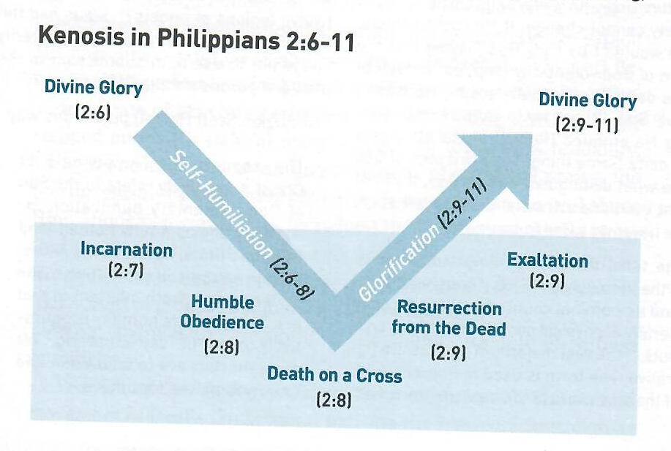

Slide 33
Philippians 2:5 – 11
But once our debt was paid and His mission was accomplished, God raised His Son from the dead, glorified His human body in a miraculous resurrection, and lifted Him again to the position of highest glory and honor.
God not only exalted Jesus to the highest position of authority, but He also bestowed upon the God-man the name of highest significance—the name above every name (2:9). He who willingly bowed to the Father’s will in selfless humility is now the recipient of worship, all persons bowing in submission to Him (2:10).
Those in heaven will bow—angles and departed saints. Those on the earth will bow, from the most bitter skeptic to the most sincere disciple.

Slide 34


Slide 35
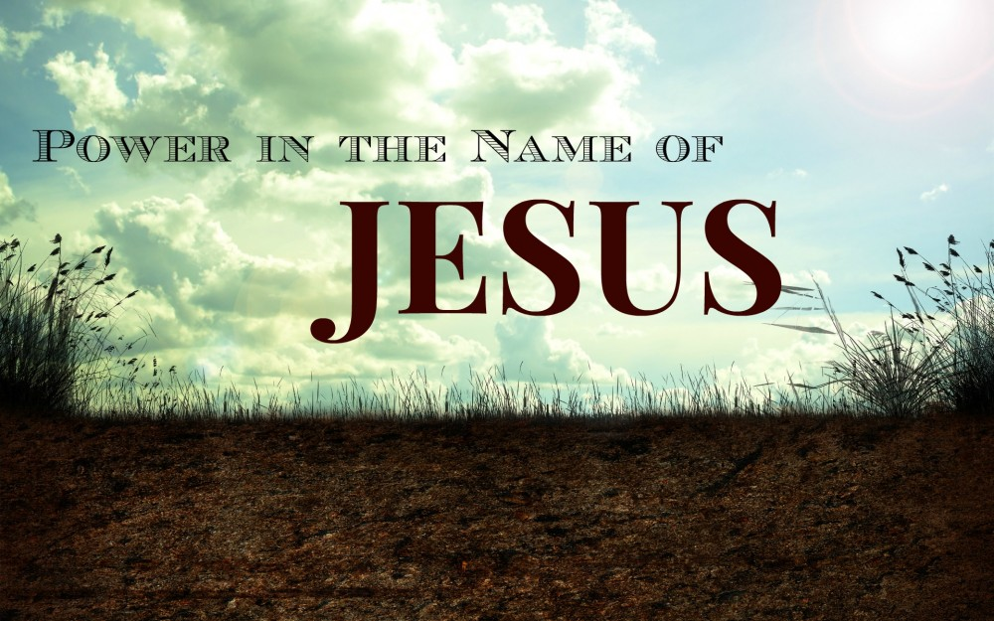

Slide 36
Philippians 2:5 – 11
And those under the earth will bow—the unsaved, the demonic, and Satan himself—in acknowledgement of the absolute lordship of Christ and His right to rule as God, Judge, and King, “to the glory of God the Father” (2:11).
If Christ, who had every right to remain enthroned on high, selflessly humbled Himself for others, why would any one of us—who have no right to exalt ourselves above anyone—think that we could do otherwise? In this way Christ becomes the perfect example of selfless humility. As Paul said to the Philippians, he says to each of us: “Have this attitude [mind] in yourselves which was also in Christ Jesus” (2:5).

Slide 37
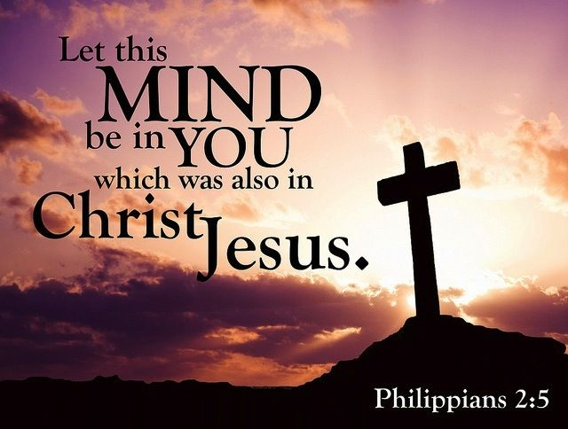

Slide 38



Slide 39
NEXT CLASS – 9 November 2022
Book of Philippians
Before next class, read the below verses in the NKJV and in one other versions of the Bible, i.e., NIV, NRSV, KJV, CEV, etc …
Chapter 2:12 – 18
“Working Out God’s inner Work”

